Slide 1
Jewish Dispensation
Exodus 19:1-8

Slide 2
Jewish Dispensation
Moses
Exodus 19
1 Year
Exodus 19 – Numbers 10 – Mt Sinai – Law
Numbers 11 – Deuteronomy 34 – Wilderness Wanderings
Joshua – 1Samuel 9 – Canaan and the Judges
United Kingdom – 120 Years (David-~1000 BC)
Divided Kingdom – 325 Years (Israel & Judah-~931 BC)
Babylonian Captivity – 70 Years (3 Attacks-606,597,586 BC)
Return – 135 Years (3 Returns-536,458,445 BC)
Silence – Time between the Testaments
Matthew – Acts 1 Jesus – Birth ~3 BC – Death ~30 AD
40 Years
Time
Covered:
1500 Years
375 Years
650 Years
400 Years
33 Years
Christ
Acts 1

Slide 3
Giving Of The Law
At Mt Sinai – Horeb
Exodus 19:1
Numbers 10:11-13

Slide 4
Giving Of The Law
At Mt Sinai – Horeb
The Law
Deuteronomy 5:5; Nehemiah 8:1,8
Deuteronomy 31:24-26
John 10:34
1Corinthians 14:21
Romans 3:9-19
Exodus 19:1-3; Deuteronomy 5:1-3
Galatians 3:19-25; Hebrews 8:7-13
Romans 7:1-7; Hebrews 10:9-10; Galatians 5:4
Romans 15:1-4; 1Corinthians 9:8-10; 10:1-12

Slide 5
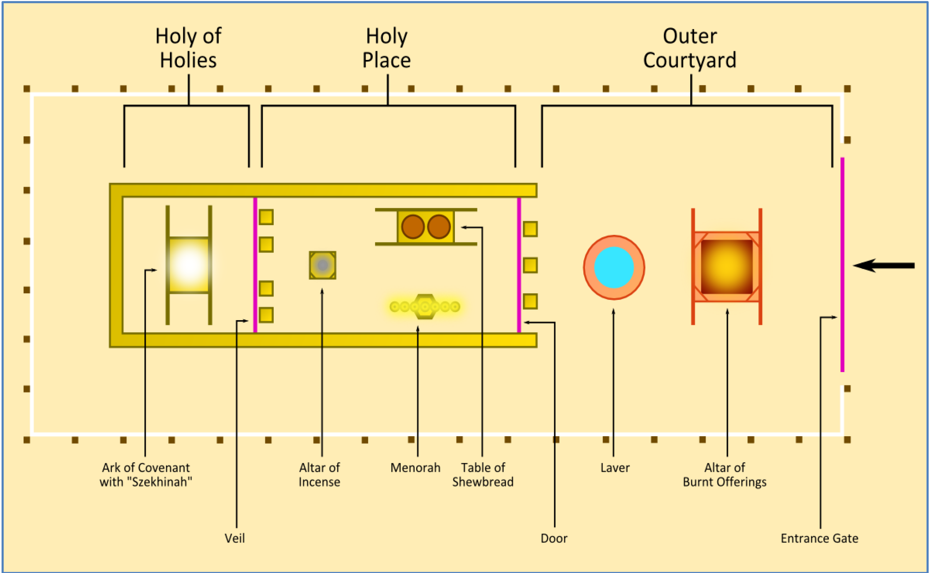

Slide 6
Giving Of The Law
At Mt Sinai – Horeb
The Law
The Tabernacle
Exodus 25:8-9
Exodus 27:5-8
Exodus 40:17
Hebrews 9:1-5
Hebrews 8:5
Exodus 40:16-32
Numbers 10:11,17,21
2Timothy 1:13-14
Hebrews 8:5; 9:6-11

Slide 7
Giving Of The Law
At Mt Sinai – Horeb
The Law
The Tabernacle
The Priesthood
Deuteronomy 18:1-2
Hebrews 5:1
Numbers 3:1-10
Exodus 27:21
Hebrews 9:6-7
Leviticus 10:8-11
Ezekiel 22:26
Numbers 18:21-24

Slide 8
Jewish Dispensation
Moses
Exodus 19
1 Year
Exodus 19 – Numbers 10 – Mt Sinai – Law
Numbers 11 – Deuteronomy 34 – Wilderness Wanderings
Joshua – 1Samuel 9 – Canaan and the Judges
United Kingdom – 120 Years (David-~1000 BC)
Divided Kingdom – 325 Years (Israel & Judah-~931 BC)
Babylonian Captivity – 70 Years (3 Attacks-606,597,586 BC)
Return – 135 Years (3 Returns-536,458,445 BC)
Silence – Time between the Testaments
Matthew – Acts 1 Jesus – Birth ~3 BC – Death ~30 AD
40 Years
Time
Covered:
1500 Years
375 Years
650 Years
400 Years
33 Years
Christ
Acts 1

