Slide 1
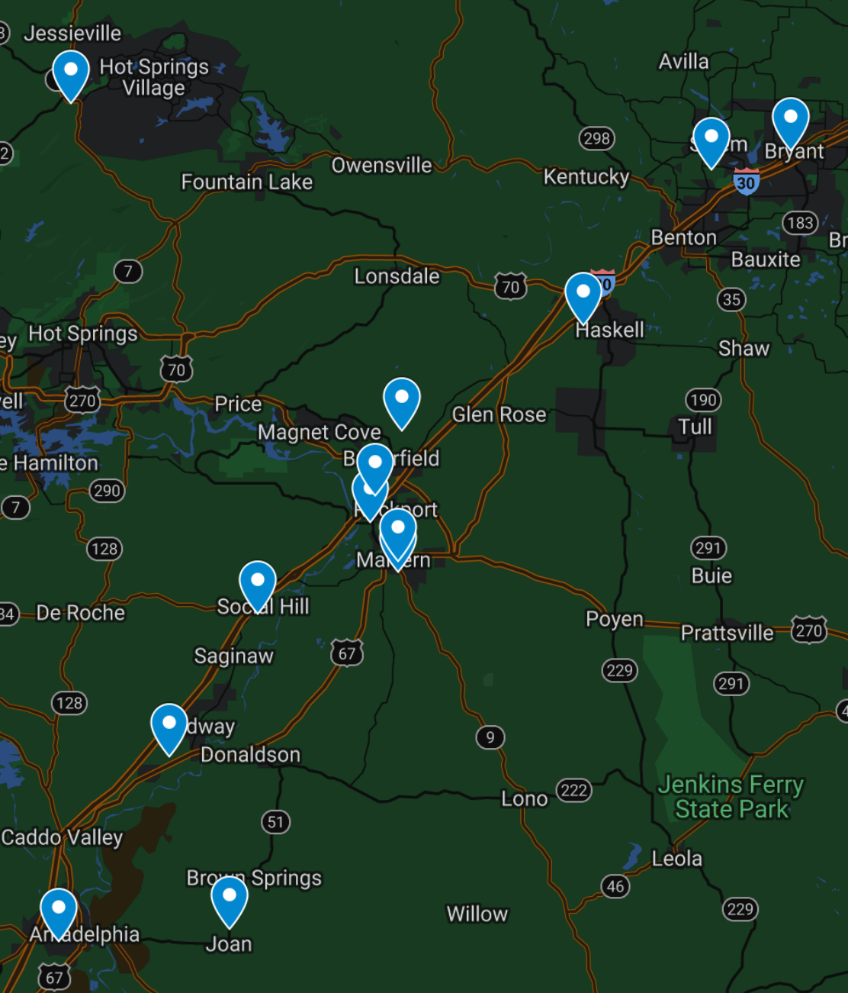
Letter To The Church
2Corinthians
13:1-10

Slide 2
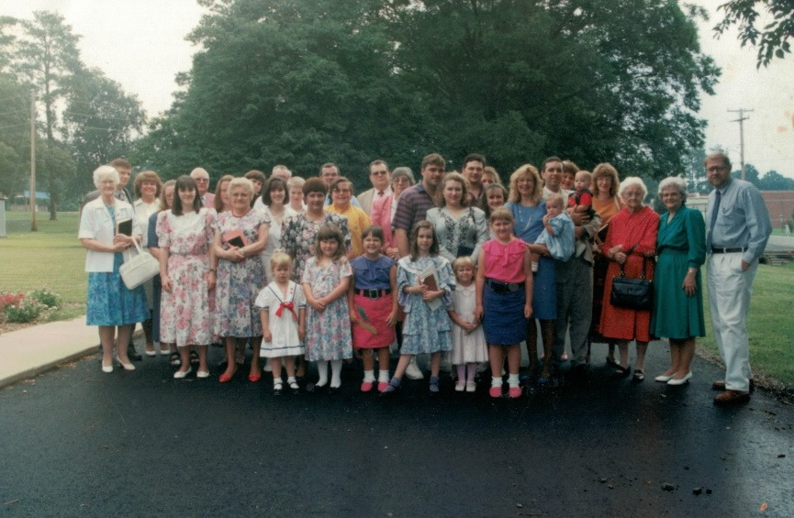
A Letter To Us?
History
Revelation 1:8-11
Revelation 1:12–20
Revelation 2-3
John 12:48
Romans 14:10
2Corinthians 5:10

Slide 3
A Letter To Us?
History
Jesus Knows Strength
1Corinthians 15:58
Matthew 7:15
2Peter 2:1
1John 4:1
2Timothy 2:15
Philippians 2:15
Philippians 4:14-16

Slide 4
A Letter To Us?
History
Jesus Knows Strength
Jesus Knows Weakness
Acts 19:9-10,20
Hebrews 10:25

Slide 5
A Letter To Us?
History
Jesus Knows Strength
Jesus Knows Weakness
Feed Our Fire
Hebrews 5:12-14
Judges 1:19-21
Matthew 12:30
John 9:4-5
John 2:10-11
Revelation 2:4
Acts 19:10,17-20
1Peter 2:2

