Slide 1
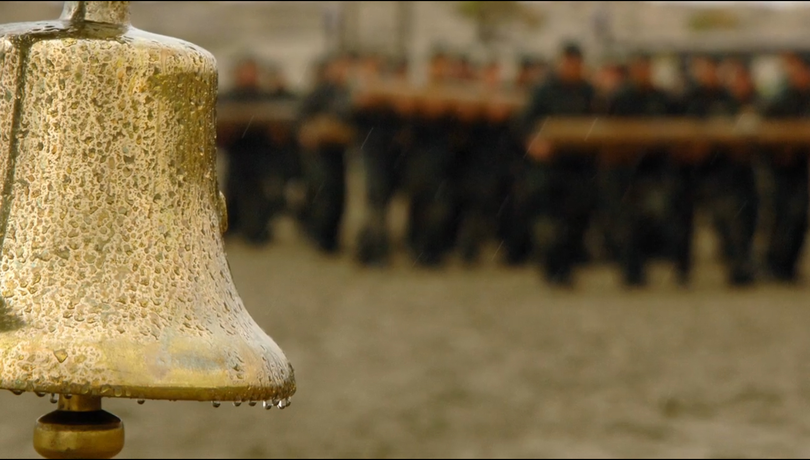
THE QUITTING BELL

Slide 2
JESUS COULD HAVE QUIT
(Mt. 26:53… John 12:27)

Slide 3
WHILE JESUS SUFFERED

Slide 4
AWFUL ANTICIPATION
Said the time of His departure had come (John 13:33)
He told them that one of them would betray Him (John 13:18,21)
Warned the disciples that they would fall (Lk. 22:31; Mt. 26:31)
How did the disciples respond? They argued over who was the greatest (Lk. 22:24)
What did Jesus do?
  He washed their feet (John 13:1-11)

Slide 5
AWFUL ANTICIPATION
Told them to keep watch / stand guard (Mk. 14:34)
His sweat became as blood (Lk. 22:44)
At that very moment, Judas is fetching the authorities.
How did the disciples respond? They slept.
What did Jesus do?
  He asked God that they could be with Him (John 17:23-24)

Slide 6
ARREST
Betrayed with a kiss (Mt. 26:49)
Arrested by cowards (Mt. 26:55)
“The hour and power of darkness are yours” (Lk. 22:53)
One disciple, not understanding, attacked and cut off a servant’s ear (Lk. 22:50)
What did Jesus do?
  He asked for His disciples to be left alone (John 18:8) and healed the servant (Lk. 22:51)

Slide 7
THE TRIALS
Jesus is tossed from court to court
He is lied about (Mt. 26:59-60)
He is beaten, spat on, and mocked (Lk. 22:63-65; Mt. 26:67-68)
Meanwhile, Peter is cursing and swearing to have never known Jesus (Mt. 26:69-75)
Jesus is found innocent (Lk. 23:4; John 18:38) but not released
The crowd asks for a murderer to be set free and for Jesus to be crucified (Mk. 15:7-14)
What did Jesus do?
  He didn’t complain. He was silent (Mt. 27:14). He didn’t quit

Slide 8
CRUCIFIXION
They hammered nails into his feet and hands (John 20:25; Acts 2:23)
They cast lots for His clothes (John 19:23-24)
They mocked Him (Mt. 27:39-44) – so did the others being crucified
This went on for six hours.
What did Jesus do?
  He prayed for His attackers to be forgiven (Lk. 23:34)
  He died (Lk. 23:46)

Slide 9
CONCLUDING THOUGHTS
God wants to save you! Never think otherwise (Rom. 5:8)
How will you treat God? What will it take to make you quit? (Heb. 10:32-39)
How will you treat others? When will you quit forgiving and stop being merciful? (Eph. 4:32-5:2)

