Slide 1

The Heavens Declare
Psalm 19:1-6

Slide 2
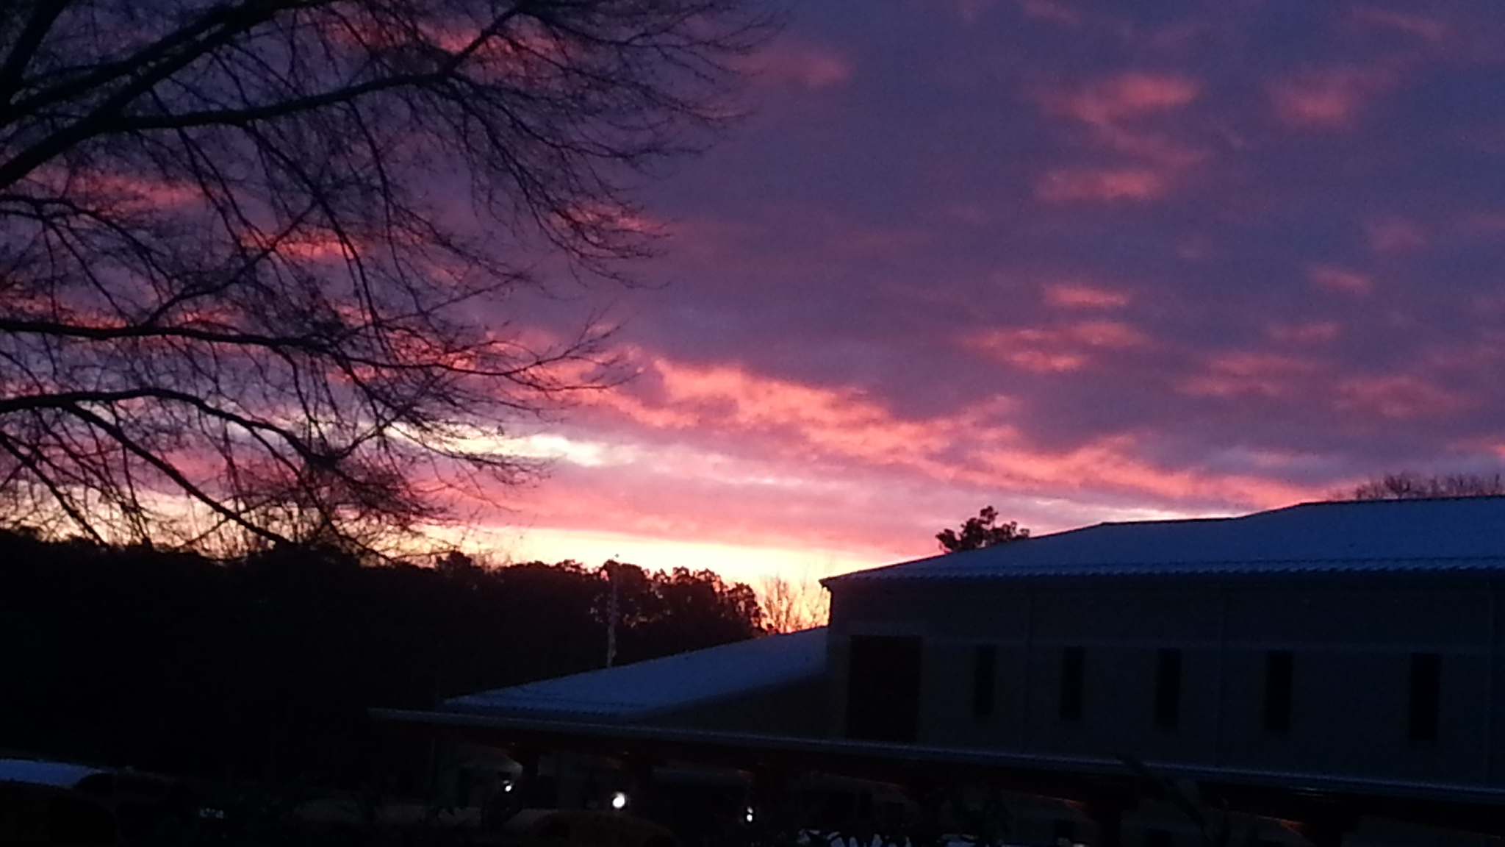
They Testify God’s Glory
Romans 1:19-20
Psalm 19:1-4

Slide 3
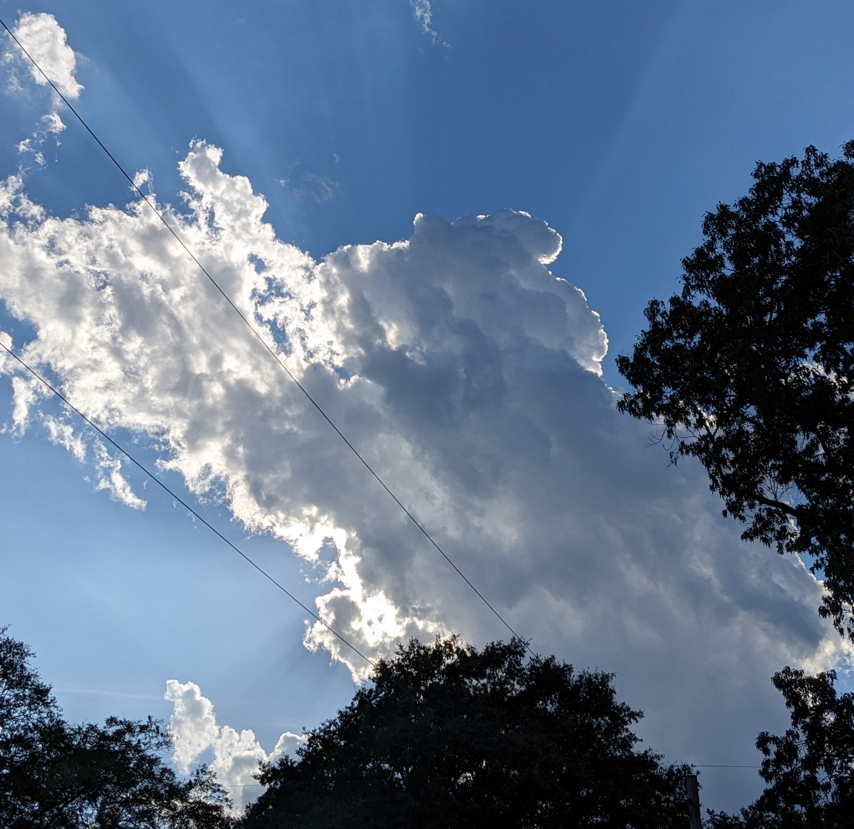
Testify To God’s Glory
Effective
Psalm 8:3-4
Psalm 33:6

Slide 4

Testify To God’s Glory
Effective
Continual
Acts 14:17
Hebrews 11:3

Slide 5
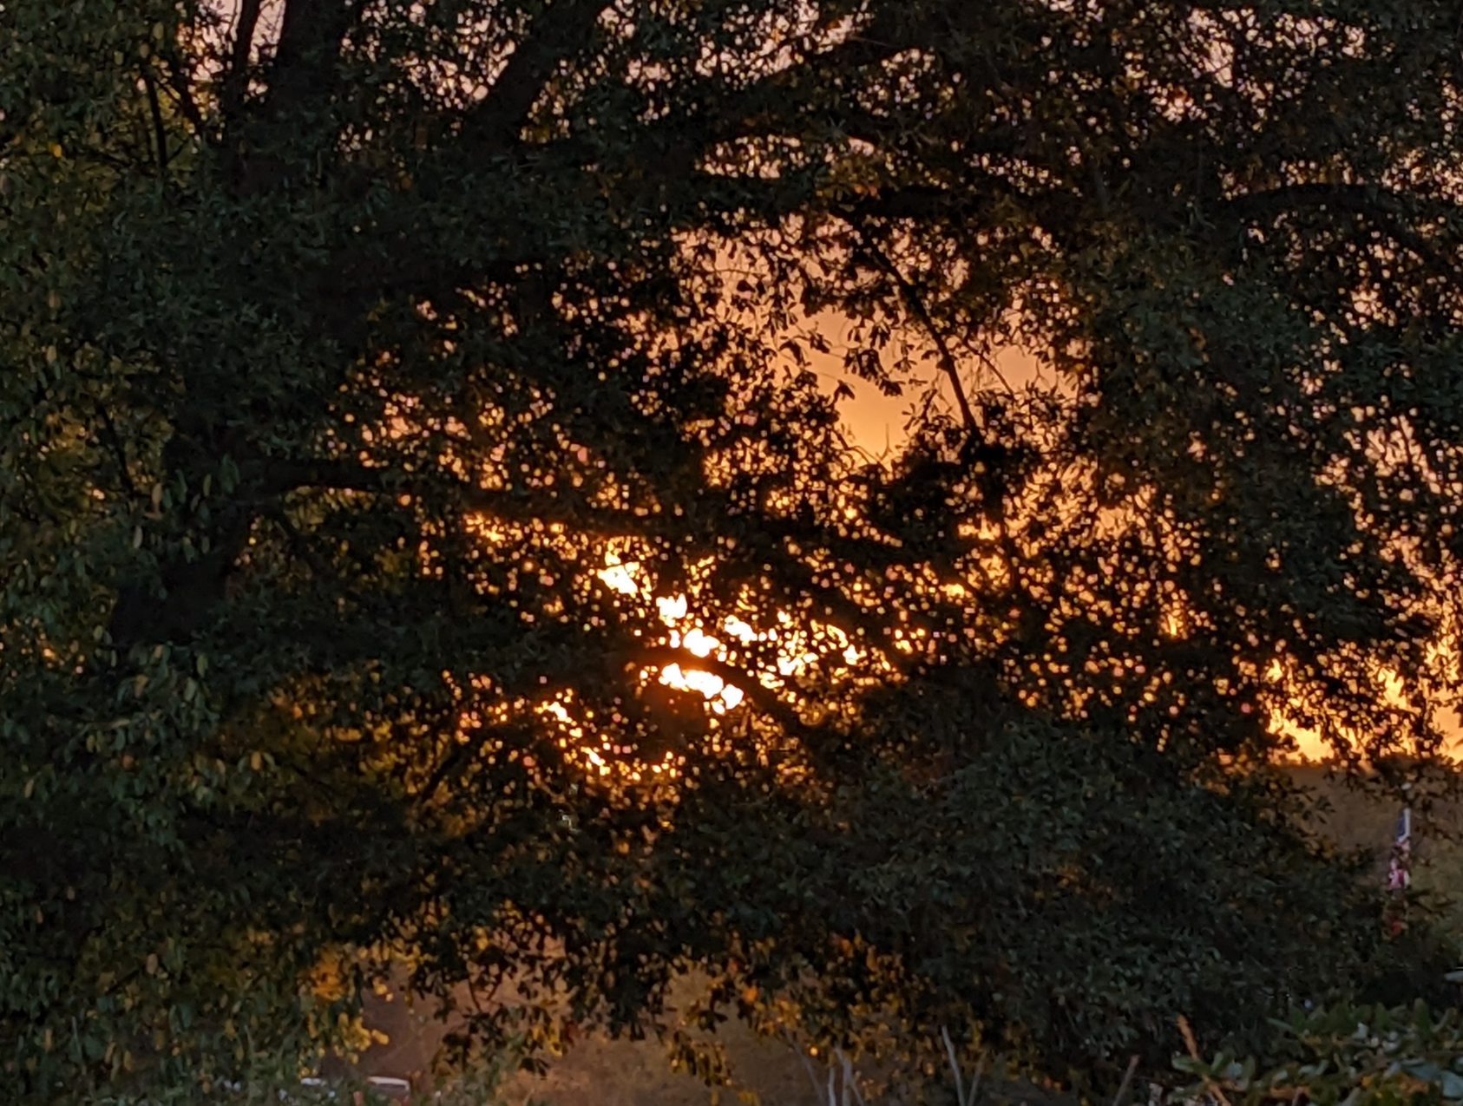
Testify To God’s Glory
Effective
Continual
Silent
Genesis 1:1

Slide 6

Testify To God’s Glory
Effective
Continual
Silent
Universal
Romans 1:19-20
Hebrews 3:4

Slide 7
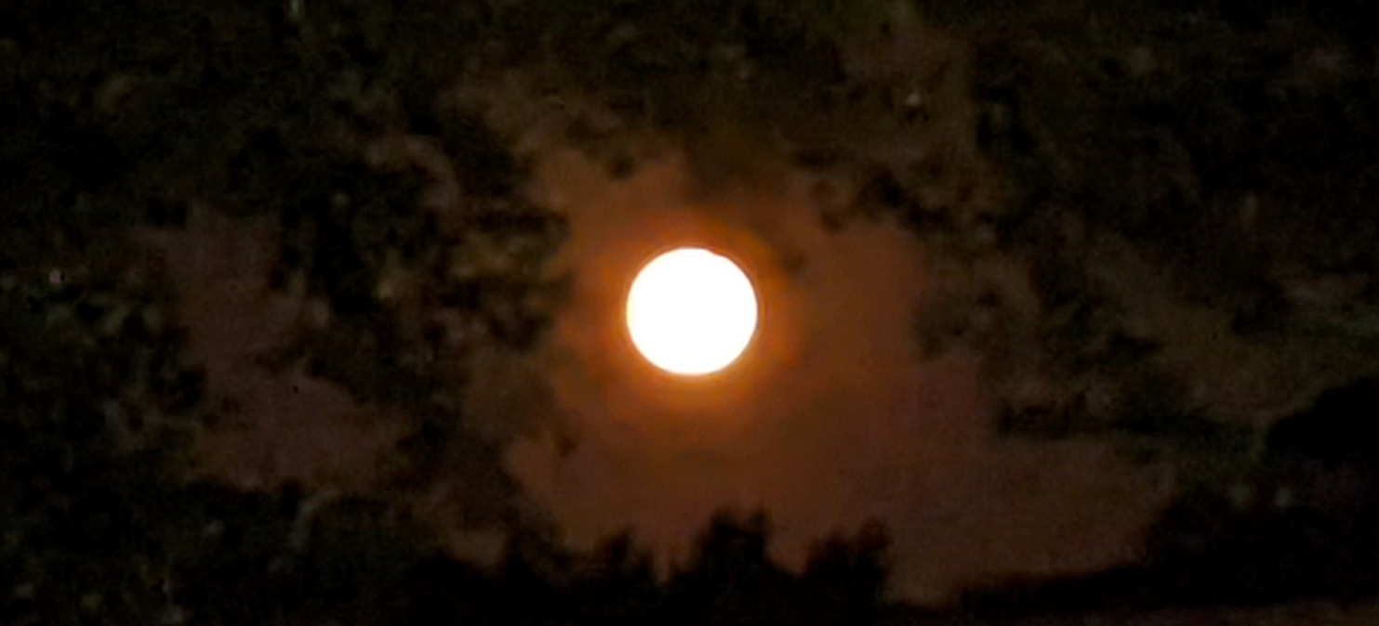
Testify To God’s Glory
Effective
Continual
Silent
Universal
Clear
Psalm 19:4-6
Psalm 19:7-11
Romans 1:23

