Slide 1
DISCIPLES and CATS

Slide 2
OUR MISSION
“Go therefore and make disciples of all the nations, baptizing them in the name of the Father and the Son and the Holy Spirit”
Matthew 28:19

Slide 3
WHAT ARE DISCIPLES?
Followers of a teacher.
Believers of a master.
More than just a person who goes where someone else goes (Mk. 8:1,34; Lk. 7:11)
The apostles were twelve chosen men from among the disciples (Lk. 6:13). Twelve disciples were also known as apostles.
Now disciples are called Christians (Acts 11:26)

Slide 4
DISCIPLES OF CHRIST
Continue in His word (John 8:31) – Truly a disciple
Love as He loved (John 13:34-35) – Known to be a disciple
Bear much fruit (John 15:8) – Proven to be a disciple

Slide 5
TO BE A DISCIPLE OF CHRIST Luke 14:25-33
Choose Jesus over family (26)
Carry his own cross and follow Jesus (27)
Count the cost (28-32)
Give up your possessions (33)
Our goal is to create people like this rather than to get people in the water (I Cor. 1:14-17)

Slide 6
TO BE A DISCIPLE OF CHRIST Matthew 10:24-25
Submission – He has authority. He is the teacher.
Imitation – Seeking to become like Him
Expect similar treatment

Slide 7
TO BE A DISCIPLE OF CHRIST Luke 6:40
The goal is to be like the teacher
Disciples aren’t perfect… they are in training
We should be improving and accepting that growth is a process

Slide 8
Notes:
At 11 years old

Slide 9
Notes:
Karlee Ann (younger sister) looked up a picture of a cat to imitate. (10 years old)

Slide 14
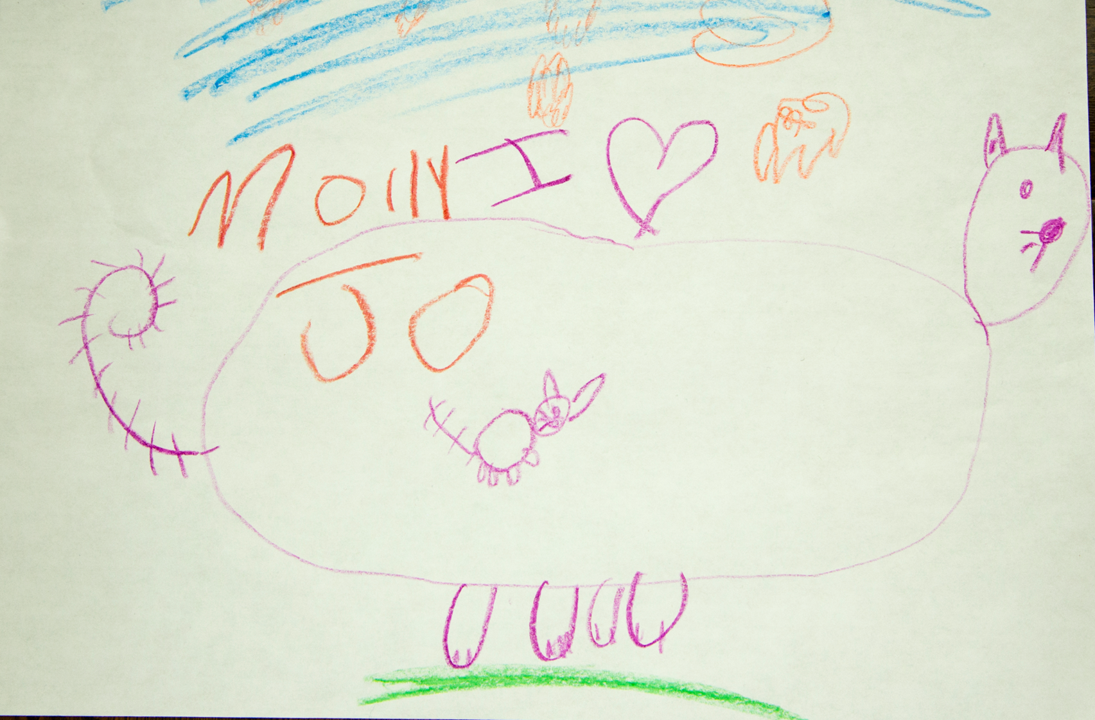
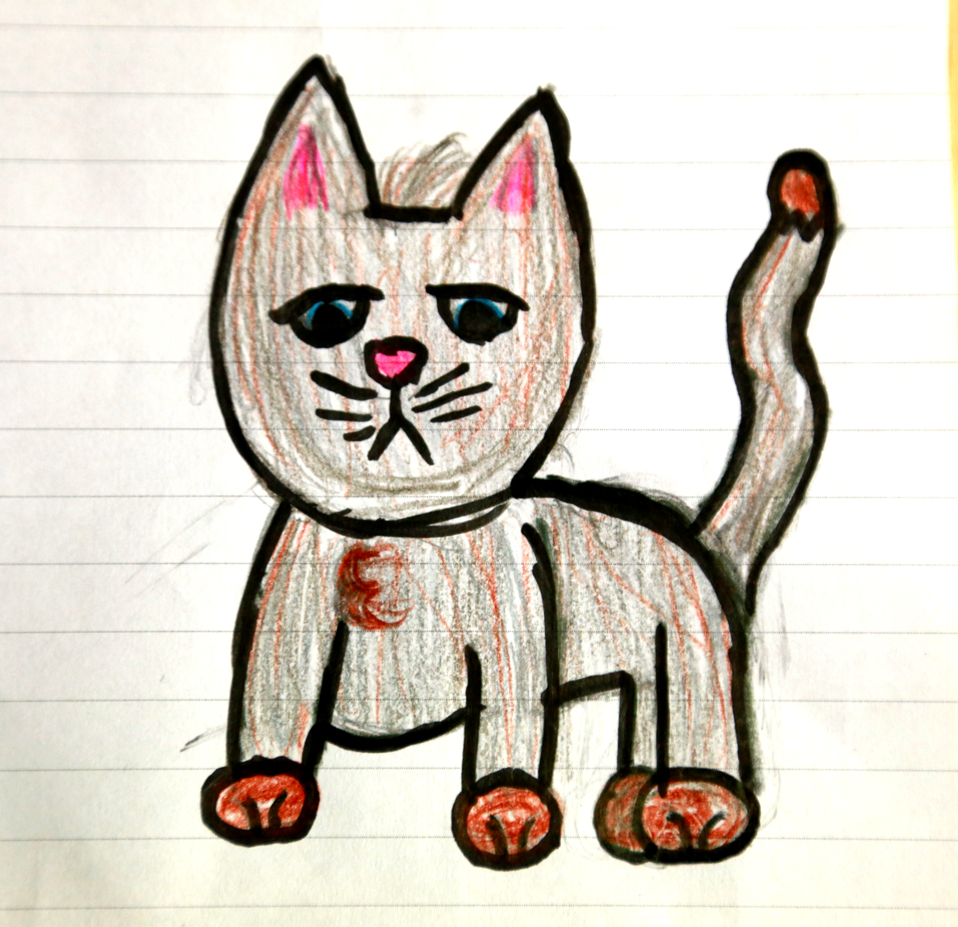
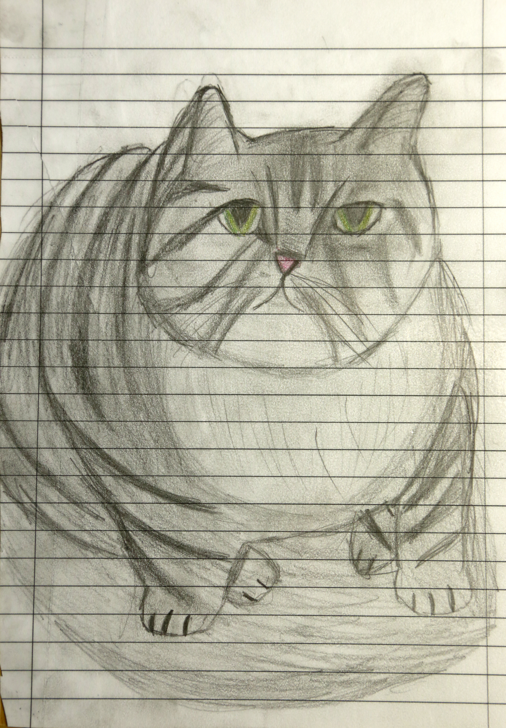
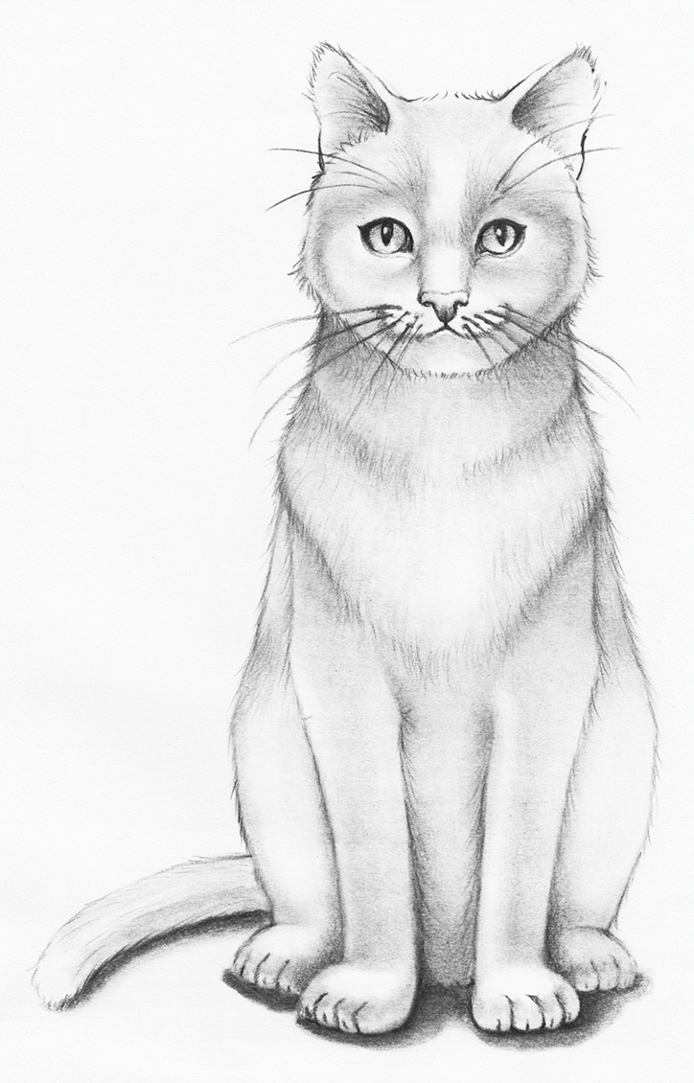
The disciple’s journey
Notes:
I used to be able to draw, but having not practiced, I have gotten much worse.

Slide 15
WHAT DISCIPLES FACED
Persecution from men and God (Acts 8:1-4; 26:11; 5:1-16; John 15:2)
Misbehaving disciples (Acts 6:1; Gal. 2:11-14; Mt. 15:23)
Difficult doctrines (Acts 10:9-16,34-35; 11:2-3,18; John 6:54-56,60-61,64,66-69)

Slide 16
WHY DISCIPLES DON’T QUIT
We follow Jesus’ example. He endured persecution and misbehaving disciples. We should expect the same. (John 15:20; I Pet. 4:12-13)
The obstacles do not change who Jesus is. He is still the Son of God and still deserves to be followed. Therefore, we still follow Him. (John 6:67-69; Mt. 15:21-28)
We have come to learn (Mt. 11:28; 10:24; Is. 55:9-7-9). It should be expected that we will be taught something we did not already know or agree with.
We want to get to where Jesus is (John 14:1-3). The obstacles do not change the goal.

Slide 17
BE A DISCIPLE
Learn from Jesus
Imitate Jesus
Remember that you are in training. You will never be perfect but always be improving.
Never quit

Slide 18
MAKE DISCIPLES
Focus on Jesus rather than water
Show that Jesus is from God and has the authority to be Lord over all
Teach the cost of discipleship

