Slide 1
Paul’s Thoughts On Death
1Corinthians 15:55-58

Slide 2
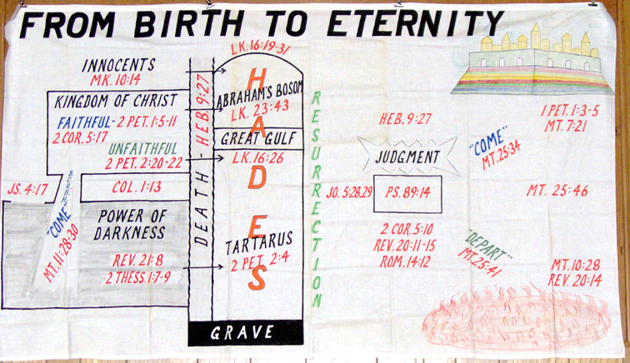
Notes:
Abraham’s Bosom - Eternal Rest
Tartarus - Eternal Destruction

Slide 3
Notes:
Everybody is worried about death

Slide 4
Paul Called It …
Sleep
Departing
Moving On
1Corinthians 15:18
1Thessalonians 4:14
Philippians 1:23
2Timothy 4:6
2Corinthians 5:1,8

Slide 5
Paul Considered It …
Beginning again
1Corinthians 15:32

Slide 6
Paul Considered It …
Beginning again
Victory
1Corinthians 15:56-57
Philippians 1:20
Romans 14:8
Acts 25:11
2Corinthians 4:16
Acts 20:24

Slide 7
Paul Considered It …
Beginning again
Victory
Anticipated
Acts 21:13
2Timothy 4:6-7
2Corinthians 5:8
Philippians 1:21,23
2Timothy 4:8
Philippians 1:24

Slide 8
Paul Readied Himself
Focus
Acts 20:26-27
1Corinthians 15:58

Slide 9
Paul Readied Himself
Focus
Faith
1Thessalonians 4:14-16
1Corinthians 15:19
2Corinthians 4:16-18

Slide 10
Paul Readied Himself
Focus
Faith
Obedience
Philippians 1:21
1Thessalonians 5:9-10
2Corinthians 5:6-9
2Timothy 4:7-8

